Slide 1
TOURIST ATTRACTIONS OF OUR REGION lithuania minges Village

Slide 2
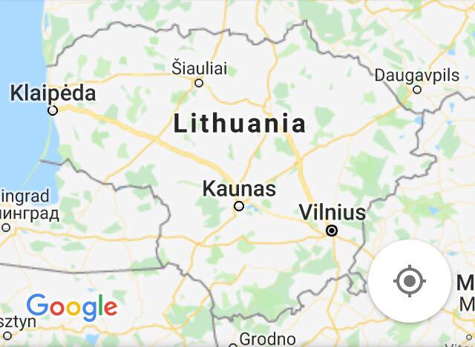
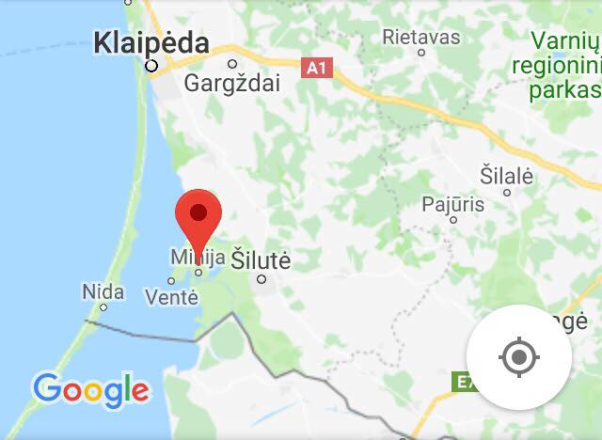
LITHUANIA MINGES VILLAGE
Map of Lithuania
Map of Minges village

Slide 3
LITHUANIA
MINGES VILLAGE
TIPE OF SITE
Architectural/Naturalistic
PHYSICAL AND AESTHETIC FEATURES
Minges village has no streets and is situated on both sides of the river Minija, therefore it is called Lithuanian Venice
This village is a good place to stay for the ones who are in thirst for a nature-for a fisher and sailor, a day tripper and a water skis‘ lover.
.
DATING
At the end of the 19th century, houses began to be built in this area.
First mentioned in 1540
HISTORICAL/SCIENTIFIC/ARTISTIC INFORMATION
In 1700, 60 people lived in this village.
In 1900, 482 people and now only 25 people live in the village.

Slide 4
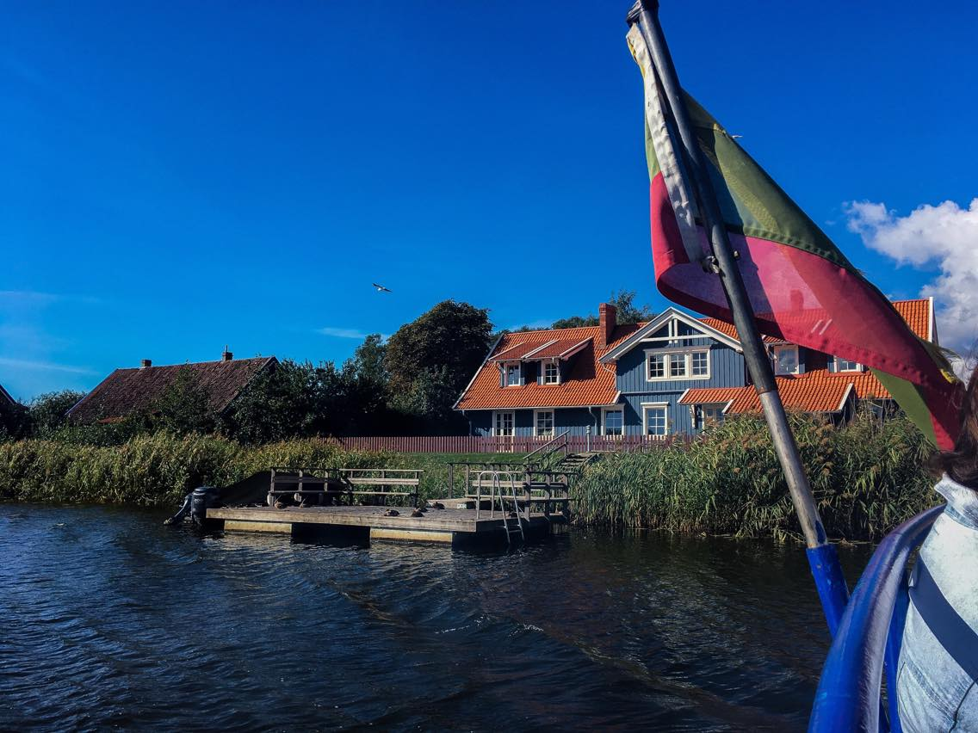
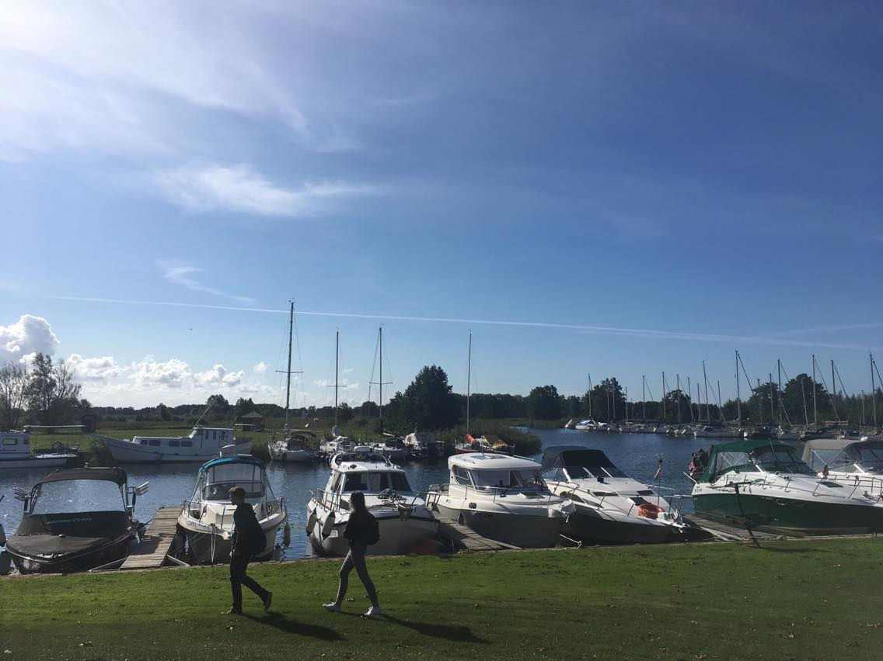
LITHUANIA
MINGES VILLAGE
HIGHLIGHTS
Travelling by ferry
A walk around the village

Slide 5
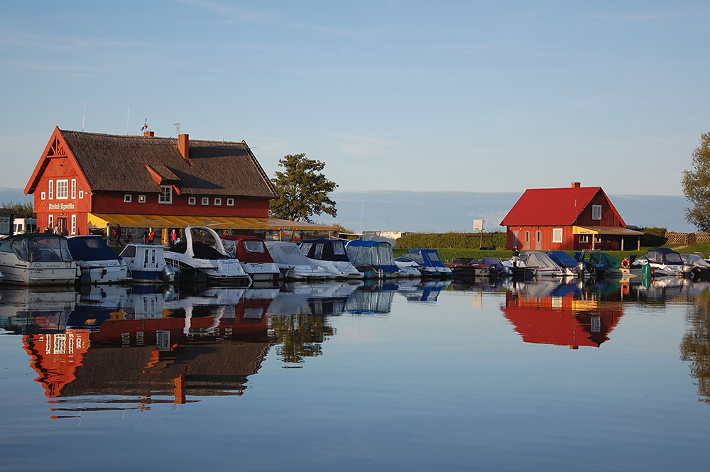
LITHUANIA
MINGES VILLAGE
CONDITION OF PRESERVATION
Minges village is well preserved by the locals, who are developing tourism buisiness in the village.
VISITING TIME
There is no visiting time, but in the winter you won’t be able to get a tour through the village by ship, because of the weather conditions
It takes about 30 minutes to visit this object and about 3 hours if you are going to Nida by boat.
TICKETS AND BOOKING
You can rent a ship on the internet, prices vary depending on the number of the passengers.

Slide 6
LITHUANIA
MINGES VILLAGE
ACCESSIBILITY
You can only reach the village by your transport.
FACILITIES
There are a fiew country houses (“Mingė recreation”, “Jono Bulavino sodyba”, “Mingės sodyba”), rural tourism homstead „Mingės Egzotika“ a hotel “Yacht Galentas” and a boat rental service “Jachta Frostas II”
Services provided:
Cafe, boating, rental of boats water bikes, saling on water skis, fishing, Lithaunian sauna, guest houses, cabins-campers.

